Slide 1

SMARTLIB
College Library Management System
Developed by:
Name: Manthan T Patel
USN: 2JH25CS061
Department : Computer Science Engineering
Subject: Innovation & Design Thinking[IBITD158]
Institution: Jain College Of Engineering And Technology
Academic Year: 2025–26
Faculty Coordinator : Prof. Somashekar T M

Slide 2





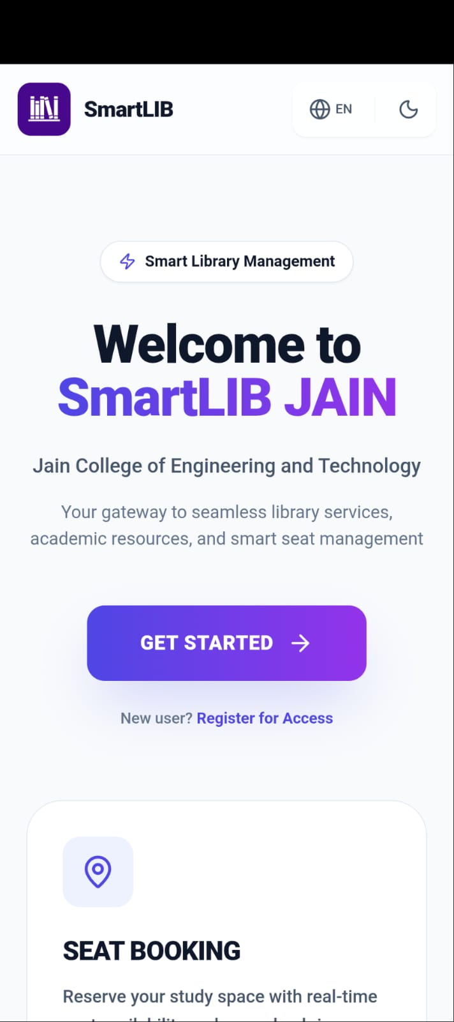

Welcome to SmartLIB
Your gateway to seamless library services, academic resources, and smart seat management.
Seat Booking
VTU Hub
Reserve your study space with real-time availability.
Access question papers, notes, and official VTU portals.
Digital ID Card
Instant verification with your digital ID QR code.

Slide 3
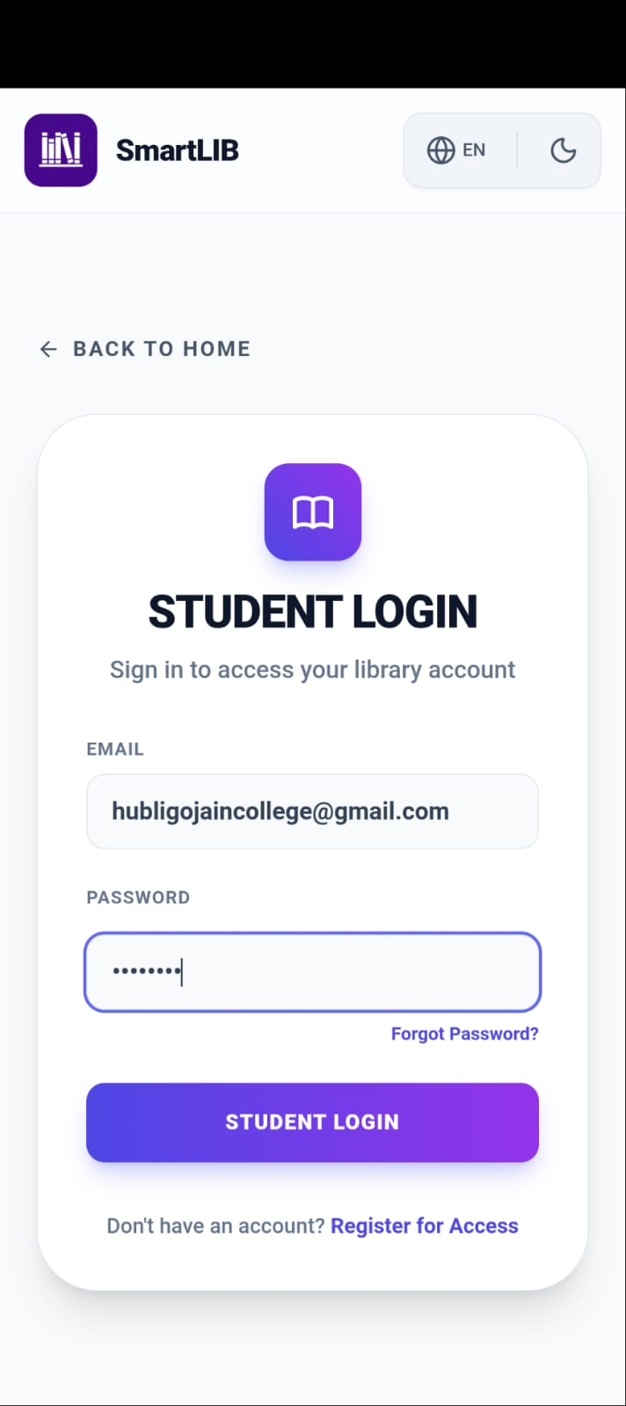
Secure User Authentication
Our system features a robust and secure login and registration process. It incorporates role-based access, differentiating between students and administrators to ensure data security and authorized access to specific functionalities.
Secure login and registration
Role-based access (Student, Admin)
Ensures data security
Authorized access control

Slide 4
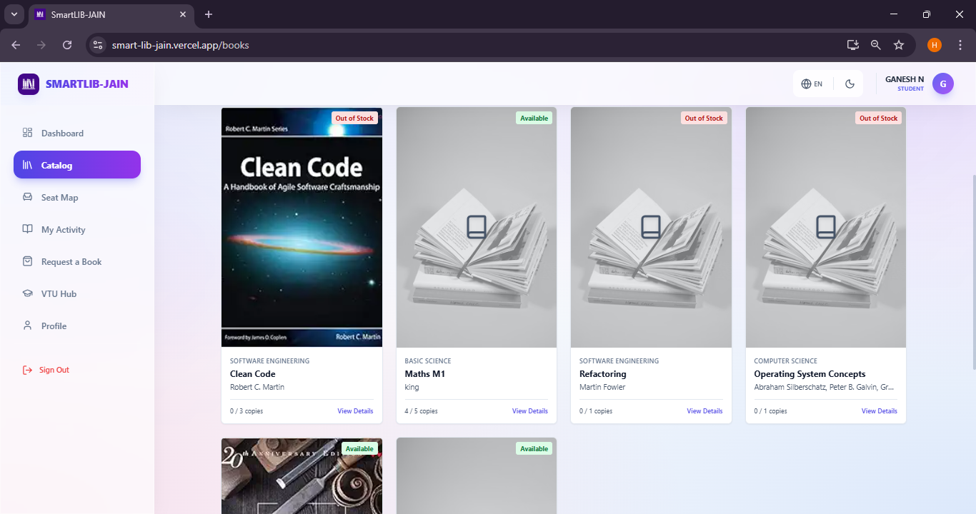
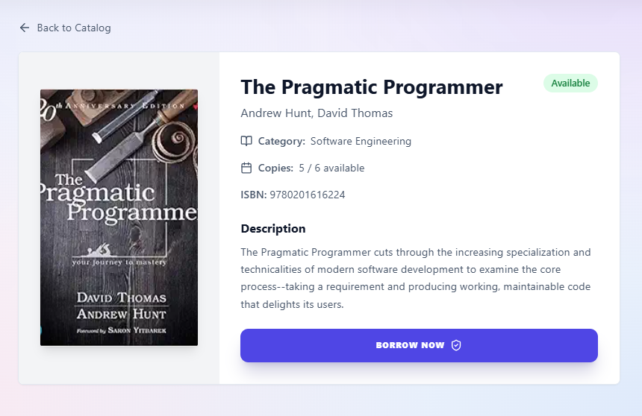
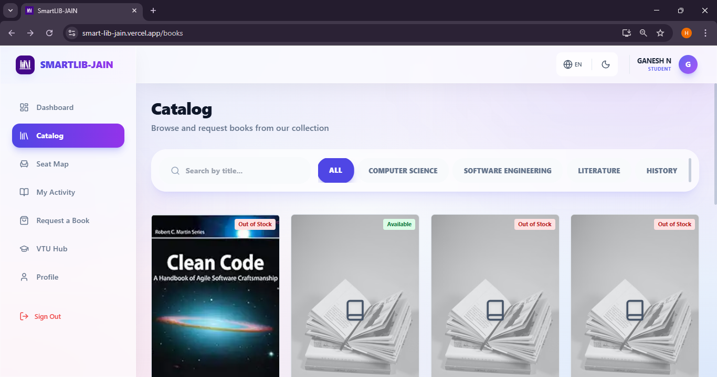
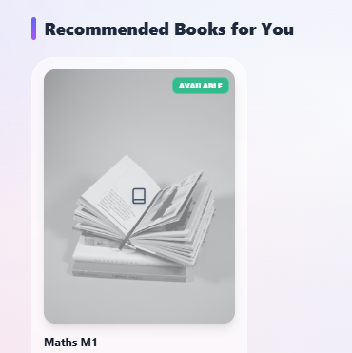

Digital Library Catalog
Comprehensive List
Detailed Information
Organized Viewing
Displays a complete, organized list of all available books.
Each entry includes title, author, category, and availability status.
Provides an easy and structured way to browse books.
AI-Based Book Recommendation
Reading Preferences
Academic Profile
Suggestions based on past reads and interests.
Recommendations tailored to courses and
study areas.

Slide 5
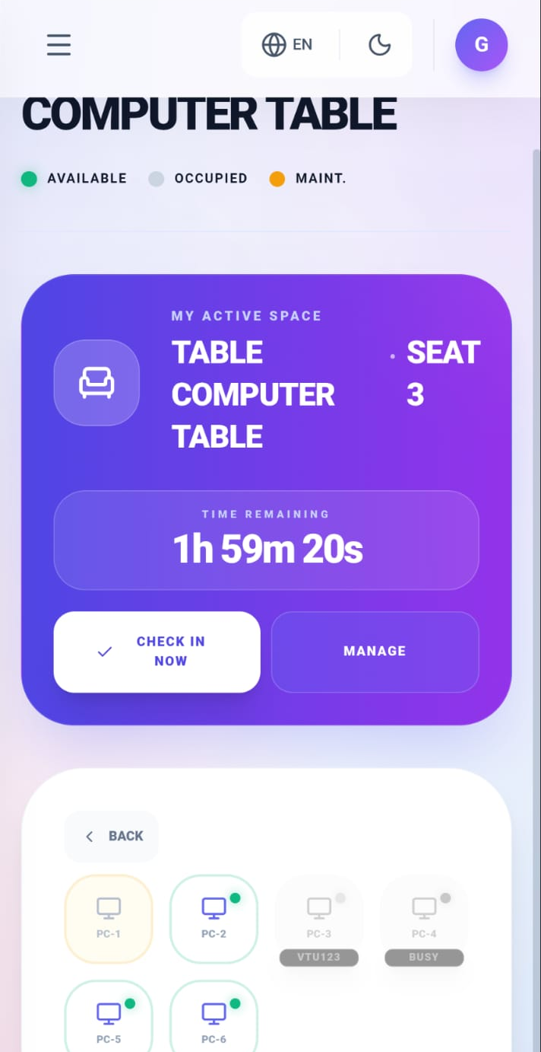
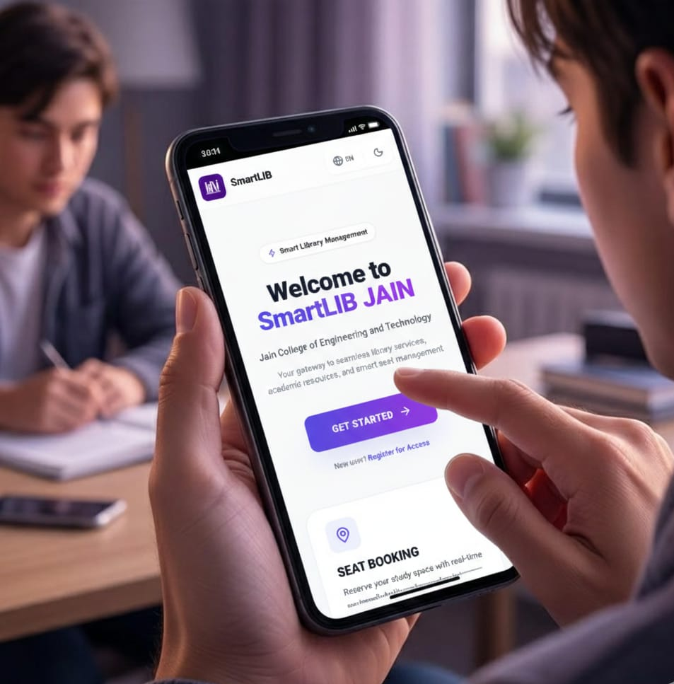

Real-time Seat Availability Tracking
Our innovative feature displays real-time library seat availability, allowing students to check seating options before entering the library. This helps prevent overcrowding and ensures a comfortable study environment for everyone.
Live updates on seat status
Helps students plan their visit
Prevents library overcrowding
Optimizes study space usage
Library in Your Pocket
Easy Access
Connect to library services anytime, anywhere.
Improved Usability
Streamlined experience for students and staff on the go.
This ensures continuous engagement and convenience for all users.

Slide 6


Online Book Reservation
01
02
Prevent Unavailability
Real-time Updates
Secure your desired books before they are checked out.
Monitor your reservation status instantly.
03
Reduce Waiting Time
Minimize queues and maximize efficiency at the library counter.
Students can reserve books online, ensuring they get the resources they need without hassle.

Slide 7


VTU Hub: Your Academic Resource Center
The VTU Hub is a dedicated portal within SmartLIB , providing essential academic resources for students.
Question Papers
Access previous year's examination papers for practice.
Notes & Study Materials
Comprehensive notes and supplementary materials for various subjects.
Lab Manuals
Detailed guides for practical laboratory sessions.
Official VTU Portals
Direct links to official Visvesvaraya Technological University resources.

Slide 8
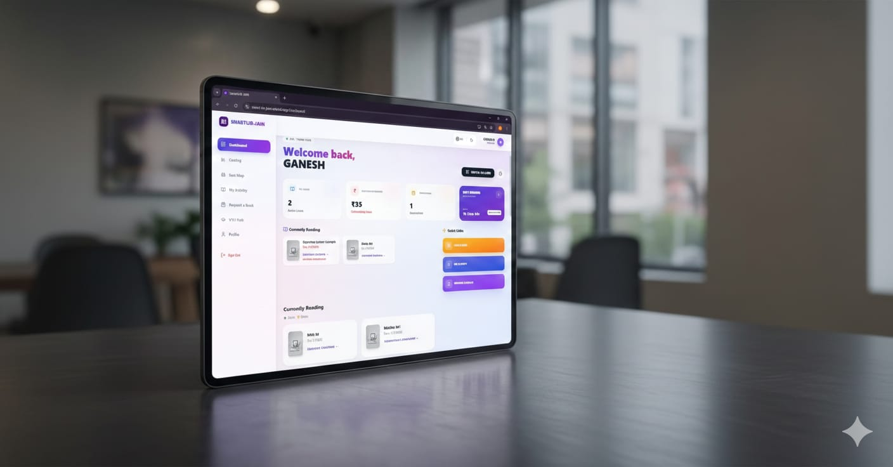
Personalized Student Dashboard
Issued Books
View a list of all books currently checked out.
Due Dates
Keep track of upcoming return deadlines.
Seat Status
Monitor your reserved seat information.
Each student receives a personalized dashboard, offering a simple and user-friendly interface to manage their library activities and stay informed.

Slide 9

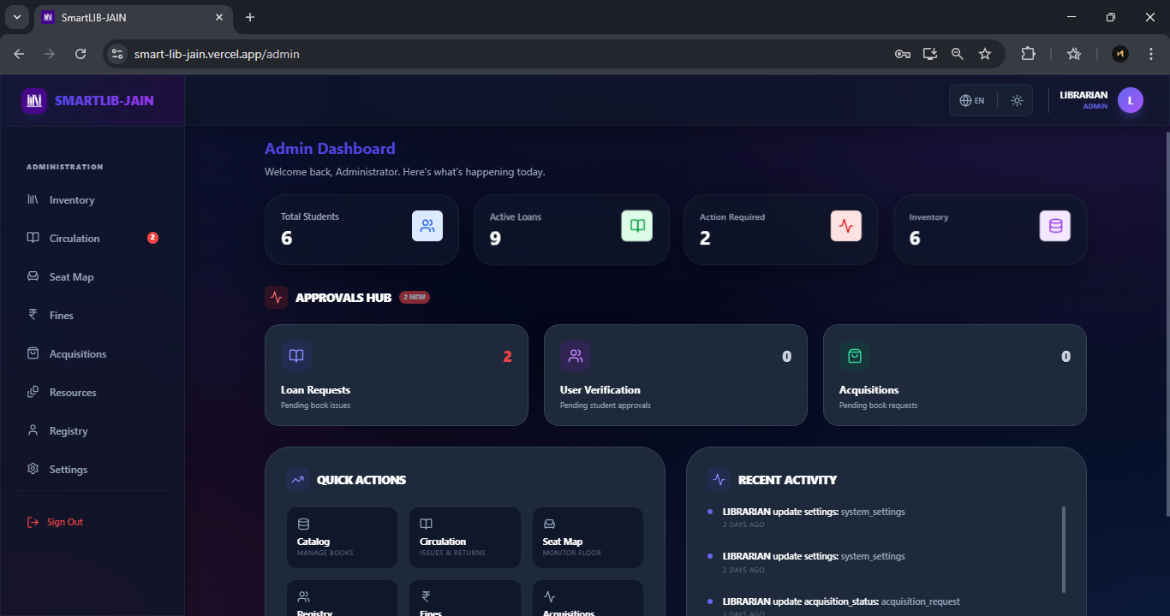
Admin Dashboard: Centralized Control
Manage Users
Update Book Details
Oversee student and staff accounts, permissions, and
activity.
Maintain accurate and current information for all library resources.
Delete Book Records
Add New Books
Remove outdated or lost book entries with ease.
Efficiently catalog new additions to the library collection.
The admin dashboard provides comprehensive control over all library data and operations.

Slide 10





Technologies Powering SmartLIB
Frontend: React
Backend: Supabase
Database: PostgreSQL
Dynamic and responsive user interfaces.
Robust and scalable backend services.
Reliable and powerful data storage.
Mobile App: Web-to-App (APK)
Hosting: Vercel
Seamless mobile experience.
Fast and efficient deployment.

Slide 11



Key Advantages of SmartLIB
Web & Mobile Access
Online Reservation
Paperless & Automated
Flexible access from any device.
Convenient book booking system.
Eco-friendly and efficient operations.
User-Friendly Interface
Time-Saving
Intuitive design for all users.
Reduces administrative and user wait times.
Future Enhancements: Innovating Tomorrow's Library
QR Code Based Book Issue &
Return
2
Online Fine Payment
3
RFID Integration
Automated fine calculation with UPI/online payment.
Improved book tracking and security.
Faster transactions using QR scanning.
Enhanced AI Recommendation
5
Multi-Library Support
More accurate recommendations via user behavior analysis.
Manage multiple libraries under one system.

Slide 12

Thank You!
Questions or interested in exploring SmartLIB?
Website
Code Repository
https://smart-lib-jain.vercel.app/login
https://github.com/SmartLIBJain/
SmartLIB-JAIN.git
Scan to Download APK
Gemini Canva Design
https://gemini.google.com/
share/01494bb15410
Contact us for demos or access.

